Slide 1

Chapter 8, Object Design: Reusing Pattern Solutions

Slide 2
Object Design
Purpose of object design:
Prepare for the implementation of the system model based on design decisions
Transform the system model (optimize it)
Investigate alternative ways to implement the system model
Use design goals: minimize execution time, memory and other measures of cost.
Object design serves as the basis of implementation.
Notes:
Object design is the process of adding details to the requirements analysis and making implementation decisions
The object designer must choose among different ways to implement the analysis model with the goal to minimize execution time, memory and other measures of cost.
Requirements Analysis: Use cases, functional and dynamic model deliver operations for object model
Object Design: Iterates on the models, in particular the object model and refine the models
Object Design serves as the basis of implementation

Slide 3
Object Design Activities
During object design, we close the gap between the application objects and the off-the-shelf components by identifying additional solution objects and refining existing objects. Object design includes:
reuse, during which we identify off-the-shelf components and design patterns to make use of existing solutions
service specification, during which we precisely describe each class interface
object model restructuring, during which we transform the object design model to improve its understandability and extensibility
model optimization, during which we transform the object design model to address performance criteria such as response time or memory utilization.

Slide 4
An overview of the Object Design
Conceptually, software system development fills the gap between a given problem and an existing machine.
Analysis reduces the gap between the problem and the machine by identifying objects representing problem-specific concepts.
System design reduces the gap between the problem and the machine in two ways. First, system design results in a virtual machine that provides a higher level of abstraction than the machine. This is done by selecting off-the-shelf components for standard services such as middleware, user interface toolkits, application frameworks, and class libraries. Second, system design identifies off-the-shelf components for application domain objects such as reusable class libraries of banking objects.
Notes:
After several iterations of analysis and system design, the developers are usually left with
a puzzle that has a few pieces missing. These pieces are found during object design. This
includes identifying new solution objects, adjusting off-the-shelf components, and precisely
specifying each subsystem interface and class. The object design model can then be partitioned
into sets of classes that can be implemented by individual developers.

Slide 5
System Development
Notes:
Figure 8-1 Object design closes the gap between application objects identified during requirements
and off-the-shelf components selected during system design (stylized UML class diagram).
Off-the-shelf components are also sometimes called COTS (commercial off-the-shelf components).
Customization closes the Object Design Gap between Applplication Objects and System Design Objects

Slide 6
Customization: Build Custom Objects
Problem: Close the object design gap
Develop new functionality
Main goal:
Reuse knowledge from previous experience
Reuse functionality already available
Composition (also called Black Box Reuse)
New functionality is obtained by aggregation
The new object with more functionality is an aggregation of existing objects
Inheritance (also called White-box Reuse)
New functionality is obtained by inheritance
Notes:
Problem formulation for customization
Develop this new functionality as a set of operations of a new class or adapt an existing program to a new environment or a new customer.
So, the goal is to produce custom objects to close the object design gap.

Slide 7
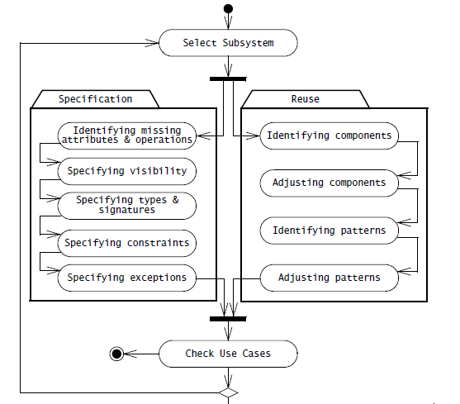
Activities of Object Design
Notes:
Customization closes the Object Design Gap between Applplication Objects and
System Design Objects

Slide 8
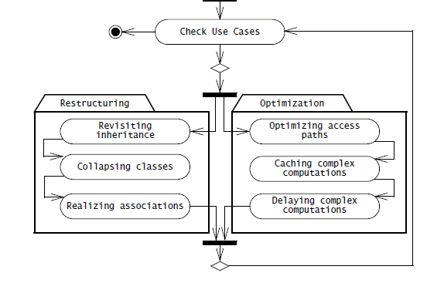
Activities of Object Design_2

Slide 9
Application Objects and Design Objects
Application objects, also called “domain objects,” represent concepts of the domain that are relevant to the system.
Solution objects represent components that do not have a counterpart in the application domain, such as persistent data stores, user interface objects, or middleware.
During system design, we identify solution objects in terms of software and hardware platforms.
During object design, we refine and detail both application and solution objects and identify additional solution objects needed to bridge the object design gap.

Slide 10
Identification of new Objects during Object Design
Requirements Analysis
(Language of Application
Domain)
Incident
Report
Incident
Report
Text box
Menu
Scrollbar
Object Design
(Language of Solution Domain)

Slide 11
Specification Inheritance and Implementation Inheritance
During analysis, we use inheritance to classify objects into taxonomies. This allows us to differentiate the common behavior of the general case, that is, the parent (also called the “base class”), from the behavior that is specific to specialized objects, that are, the children classes (also called the “derived classes”).
During object design, the focus of inheritance is to reduce redundancy and enhance extensibility. By factoring all redundant behavior into a single parent class, we reduce the risk of introducing inconsistencies during changes (e.g., when repairing a defect) since we have to make changes only once for all children classes. By providing abstract classes and interfaces that are used by the application, we can write new specialized behavior.

Slide 12
Specification Inheritance and Implementation Inheritance_2
Although inheritance can make an analysis model more understandable and an object design model more modifiable or extensible, these benefits do not occur automatically.
On the contrary, inheritance is such a powerful mechanism that novice developers often produce code that is more obfuscated and more brittle than if they had not used inheritance in the first place.

Slide 13
Specification Inheritance and Implementation Inheritance_3
/* Implementation of MySet using
inheritance */
class MySet extends Hashtable {
/* Constructor omitted */
MySet() {
}
void put(Object element) {
if (!containsKey(element)){
put(element, this);
}
}
boolean containsValue(Object
element){
return containsKey(element);
}
/* Other methods omitted */
}
Notes:
In this example, two previously unrelated concepts, Hashtable and Set, become tightly
coupled as a result of subclassing, introducing many issues when Hashtable is modified
or when a Set is used by a class as a specialized Hashtable. The fundamental problem in
this example is that, although Hashtable provides behavior that we would like to reuse in
implementing Set, because that would save us time, there is no taxonomy in which the
Set concept is related to the Hashtable concept.
The use of inheritance for the sole purpose of reusing code is called implementation
inheritance. With implementation inheritance, developers reuse code quickly by subclassing an
existing class and refining its behavior. A Set implemented by inheriting from a Hashtable is an
example of implementation inheritance. Conversely, the classification of concepts into type
hierarchies is called specification inheritance (also called “interface inheritance”).

Slide 14
Specification Inheritance and Implementation Inheritance_4
/* Implementation of MySet using
delegation */
class MySet {
private Hashtable table;
MySet() {
table = Hashtable();
}
void put(Object element) {
if (!containsValue(element)){
table.put(element,this);
}
}
boolean containsValue(Object
element) {
return
(table.containsKey(element));
}
/* Other methods omitted */
}

Slide 15
Inheritance metamodel
Analysis
activity
Object
Design
Figure 8-4 Inheritance meta-model (UML class diagram).
Notes:
In object-oriented analysis and design, inheritance is used for achieving several goals, in particular
modeling taxonomies and reusing behavior from abstract classes. When modeling taxonomies,
the inheritance relationships can be identified either during specializations (when specialized classes
are identified after general ones) or during generalizations (when general classes are abstracted out
of a number of specialized ones). When using inheritance for reuse, specification inheritance represents
subtyping relationships, and implementation inheritance represents reuse among conceptually
unrelated classes.

Slide 16
Delegation
Delegation is the alternative to implementation inheritance that should be used when reuse is desired.
A class is said to delegate to another class if it implements an operation by referring another operation of the other class.
Delegation makes explicit the dependencies between the reused class and the new class. The right column of Figure 8-3 shows an implementation of MySet using delegation instead of implementation inheritance. The only significant change is the private field table and its initialization in the MySet() constructor.
Notes:
This addresses both problems we mentioned before:
• Extensibility. The MySet on the right column does not include the containsKey()
method in its interface and the new field table is private. Hence, we can change the
internal representation of MySet to another class (e.g., a List) without impacting any
clients of MySet.
• Subtyping. MySet does not inherit from Hashtable and, hence, cannot be substituted for
a Hashtable in any of the client code. Consequently, any code previously using
Hashtables still behaves the same way.

Slide 17
Delegation
Delegation is a way of making composition as powerful for reuse as inheritance
In delegation two objects are involved in handling a request from a Client
The Receiver object delegates operations to the Delegate object
The Receiver object makes sure, that the Client does not misuse the Delegate object.
Client
Receiver
Delegate
calls
delegates to

Slide 18
Comparison: Delegation v. Inheritance
Code-Reuse can be done by delegation as well as inheritance
Delegation
Flexibility: Any object can be replaced at run time by another one
Inefficiency: Objects are encapsulated
Inheritance
Straightforward to use
Supported by many programming languages
Easy to implement new functionality
Exposes a subclass to details of its super class
Change in the parent class requires recompilation of the subclass.
Notes:
Flexibility: Any object can be replaced at run time by another one (as long as it has the same type)
Last in Inheritance disadvantages: Any change in the parent class implementation forces the subclass to change (which requires recompilation of both)

Slide 19
The Liskov Substitution Principle
If an object of type S can be substituted in all the places where an object of type T is expected, then S is a subtype of T.
An inheritance relationship that complies with the Liskov Substitution Principle is called strict inheritance.

Slide 20
Delegation and Inheritance in Design Patterns
In object-oriented development, design patterns are template solutions that developers have refined over time to solve a range of recurring problems [Gamma et al., 1994]. A design pattern has four elements:
A name that uniquely identifies the pattern from other patterns.
A problem description that describes the situations in which the pattern can be used. Problems addressed by design patterns are usually the realization of modifiability and extensibility design goals and nonfunctional requirements.
A solution stated as a set of collaborating classes and interfaces.
4. A set of consequences that describes the trade-offs and alternatives to be considered with respect to the design goals being addressed.

Slide 21
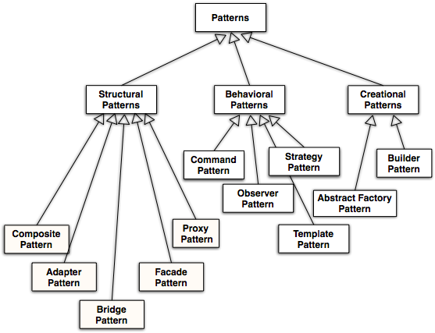

A Taxonomy of Design Patterns
√
√
√
√

Slide 22
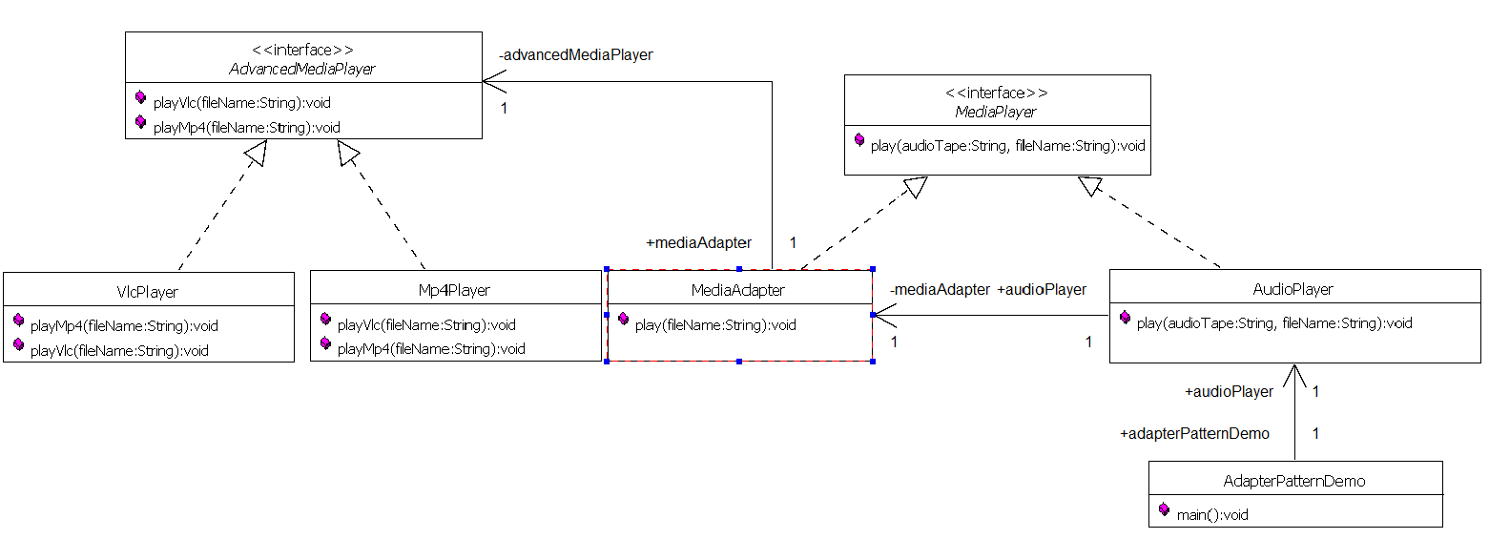
The Adapter Pattern
Adapter pattern works as a bridge between two incompatible interfaces. This design pattern comes under structural pattern as this pattern combines the capability of two independent interfaces.
This pattern involves a single class MediaAdapter which is responsible to join functionalities of independent or incompatible interfaces.

Slide 23
The Adapter Pattern_2
public static void main(String[] args) {
AudioPlayer audioPlayer = new AudioPlayer();
audioPlayer.play("mp3", "beyond the horizon.mp3");
audioPlayer.play("mp4", "alone.mp4");
audioPlayer.play("vlc", "far far away.vlc");
audioPlayer.play("avi", "mind me.avi");
}

Slide 24
The Adapter Pattern_3
if(audioType.equalsIgnoreCase("mp3")){
System.out.println("Playing mp3 file. Name: " + fileName);
}
else if(audioType.equalsIgnoreCase("vlc") || audioType.equalsIgnoreCase("mp4")){
mediaAdapter = new MediaAdapter(audioType);
mediaAdapter.play(audioType, fileName);
}
else{
System.out.println("Invalid media. " + audioType + " format not supported");
}
}

Slide 25
The Adapter Pattern_3
public MediaAdapter(String audioType){
if(audioType.equalsIgnoreCase("vlc") ){
advancedMusicPlayer = new VlcPlayer();
}else if (audioType.equalsIgnoreCase("mp4")){
advancedMusicPlayer = new Mp4Player();
}
}

Slide 26
The Adapter Pattern_4
@Override
public void play(String audioType, String fileName) {
if(audioType.equalsIgnoreCase("vlc")){
advancedMusicPlayer.playVlc(fileName);
}
else if(audioType.equalsIgnoreCase("mp4")){
advancedMusicPlayer.playMp4(fileName);
}
}

Slide 27
The Adapter Pattern_5
@Override
public void playMp4(String fileName) {
}
@Override
public void playVlc(String fileName) {
System.out.println("Playing Vlc file. Name: "+ fileName);
}
@Override
public void playVlc(String fileName) {
}
@Override
public void playMp4(String fileName) {
System.out.println("Playing mp4 file. Name: "+ fileName);
}

Slide 28
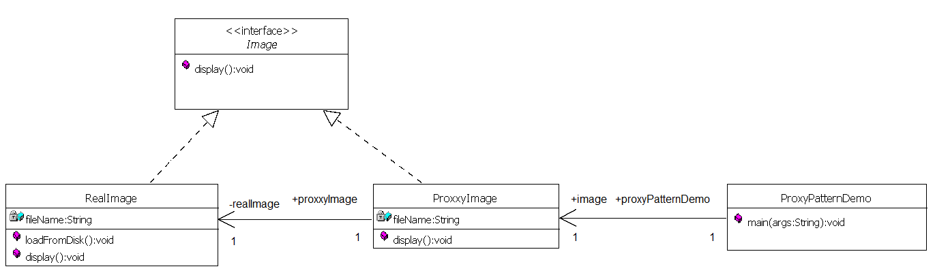
The Proxy Pattern
The ProxyObject class acts on behalf of a RealObject class. Both classes implement the same interface. The ProxyObject stores a subset of the attributes of the RealObject.
The ProxyObject handles certain requests completely (e.g., determining the size of an image), whereas others are delegated to the RealObject. After delegation, the RealObject is created and loaded in memory.

Slide 29
The Proxy Pattern_2
public static void main(String[] args) {
Image image = new ProxyImage("test_10mb.jpg");
//image will be loaded from disk
image.display();
System.out.println("");
//image will not be loaded from disk
image.display();
}

Slide 30
The Proxy Pattern_3
public RealImage(String fileName){
this.fileName = fileName;
loadFromDisk(fileName);
}
@Override
public void display() {
System.out.println("Displaying " + fileName);
}
private void loadFromDisk(String fileName){
System.out.println("Loading " + fileName);
}
public ProxyImage(String fileName){
this.fileName = fileName;
}
@Override
public void display() {
if(realImage == null){
realImage = new RealImage(fileName);
}
realImage.display();
}

Slide 31
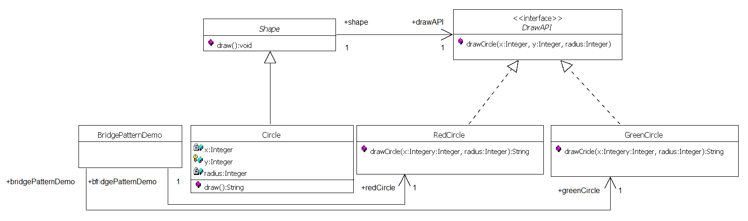
The Bridge Pattern
Bridge is used when we need to decouple an abstraction from its implementation so that the two can vary independently. The DrawAPI interface acta as a bridge implementer.
This pattern involves an interface which acts as a bridge which makes the functionality of concrete classes independent from interface implementer classes. Both types of classes can be altered structurally without affecting each otherThe concrete classes.

Slide 32
The Bridge Pattern
public static void main(String[] args) {
Shape redCircle = new Circle(100,100, 10, new RedCircle());
Shape greenCircle = new Circle(100,100, 10, new GreenCircle());
redCircle.draw();
greenCircle.draw();
}
public Circle(int x, int y, int radius, DrawAPI drawAPI) {
super(drawAPI);
this.x = x;
this.y = y;
this.radius = radius;
}
public void draw() {
drawAPI.drawCircle(radius,x,y);
}
}

Slide 33
The Bridge Pattern
protected Shape(DrawAPI drawAPI){
this.drawAPI = drawAPI;
}
public abstract void draw();
@Override
public void drawCircle(int radius, int x, int y) {
System.out.println("Drawing Circle[ color: red, radius: " + radius + ", x: " + x + ", " + y + "]");
}
@Override
public void drawCircle(int radius, int x, int y) {
System.out.println("Drawing Circle[ color: green, radius: " + radius + ", x: " + x + ", " + y + "]");
}

Slide 34
The Composite Pattern
Modern toolkits enable developers to organize the user interface objects into hierarchies of aggregate nodes, called “panels,” that can be manipulated the same way as the concrete user interface objects.
For example, our preferences dialog can include a top panel for the title of the dialog and instructions for the user, a center panel containing the checkboxes and their labels, and a bottom panel for the ‘ok’ and ‘cancel’ button.
Each panel is responsible for the layout of its subpanels, called “children,” and the overall dialog only must deal with the three panels (Figures 8-14 and 8-15).
Notes:
User interface toolkits, provide the application developer with a range of classes as building
blocks. Each class implements a specialized behavior, such as inputting text, selecting and
deselecting a check box, pushing a button, or pulling down a menu. The user interface design
can aggregate these components into Windows to build application-specific
interfaces. For example, a preferences dialog may include several on-off check boxes for
enabling different features in the application.
As windows become more complex and include many different user interface objects,
their layout (i.e., moving and resizing each component so that the window forms a coherent
whole) becomes increasingly unmanageable.

Slide 35
The Composite Pattern_2

Slide 36
The Composite Pattern_3

Slide 37
The Composite Pattern_4

Slide 38
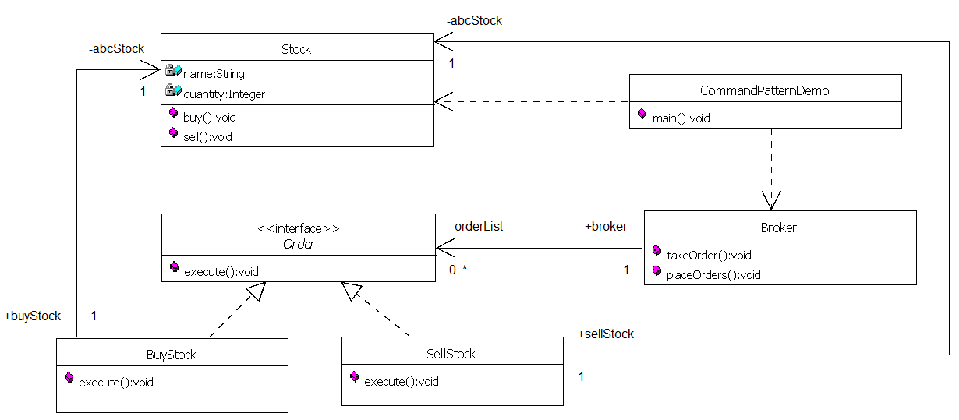
The Command Pattern
A request is wrapped under an object as command and passed to invoker object. Invoker object looks for the appropriate object which can handle this command and passes the command to the corresponding object which executes the command.

Slide 39
The Command Pattern_2
public static void main(String[] args) {
Stock abcStock = new Stock();
BuyStock buyStockOrder = new BuyStock(abcStock);
SellStock sellStockOrder = new SellStock(abcStock);
Broker broker = new Broker();
broker.takeOrder(buyStockOrder);
broker.takeOrder(sellStockOrder);
broker.placeOrders();
}

Slide 40
The Command Pattern_3
private List<Order> orderList = new ArrayList<Order>();
public void takeOrder(Order order){
orderList.add(order);
}
public void placeOrders(){
for (Order order : orderList) {
order.execute();
}
orderList.clear();
}

Slide 41
The Command Pattern_4
public BuyStock(Stock abcStock){
this.abcStock = abcStock;
}
public void execute() {
abcStock.buy();
}
public SellStock(Stock abcStock){
this.abcStock = abcStock;
}
public void execute() {
abcStock.sell();
}

Slide 42
The Command Pattern_5
private String name = "ABC";
private int quantity = 10;
public void buy(){
System.out.println("Stock [ Name: "+name+",
Quantity: " + quantity +" ] bought");
}
public void sell(){
System.out.println("Stock [ Name: "+name+",
Quantity: " + quantity +" ] sold");
}

Slide 43
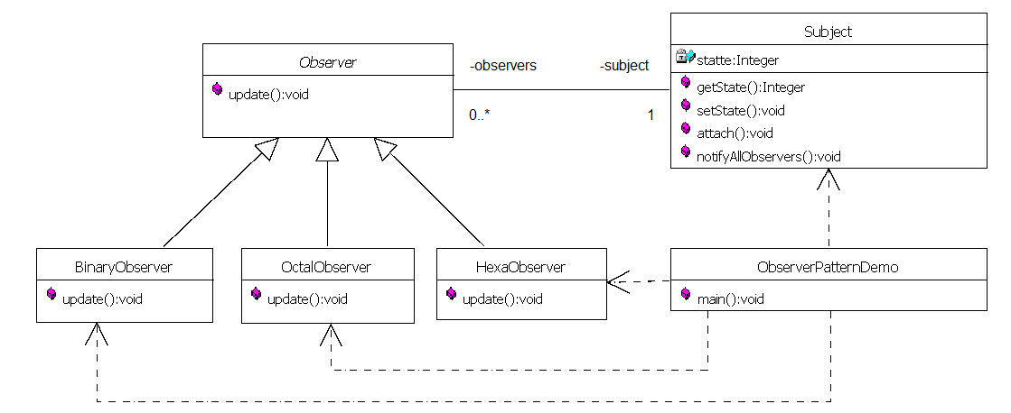
The Observer Pattern
Observer pattern is used when there is one-to-many relationship between objects such as if one object is modified, its dependent objects are to be notified automatically. Observer pattern falls under behavioral pattern category.

Slide 44
The Observer Pattern_2
public static void main(String[] args) {
Subject subject = new Subject();
new HexaObserver(subject);
new OctalObserver(subject);
new BinaryObserver(subject);
System.out.println("First state change: 15");
subject.setState(15);
System.out.println("Second state change: 10");
subject.setState(10);
}

Slide 45
The Observer Pattern_3
public int getState() {
return state;
}
public void setState(int state) {
this.state = state;
notifyAllObservers();
}
public void attach(Observer observer){
observers.add(observer);
}
public void notifyAllObservers(){
for (Observer observer : observers) {
observer.update();
}
}

Slide 46
The Observer Pattern_4
public BinaryObserver(Subject subject){
this.subject = subject;
this.subject.attach(this);
}
@Override
public void update() {
System.out.println( "Binary String: " + Integer.toBinaryString( subject.getState() ) );
}

Slide 47
The Observer Pattern_5
public OctalObserver(Subject subject){
this.subject = subject;
this.subject.attach(this);
}
@Override
public void update() {
System.out.println( "Octal String: " + Integer.toOctalString( subject.getState() ) );
}

Slide 48
The Observer Pattern_6
public HexaObserver(Subject subject){
this.subject = subject;
this.subject.attach(this);
}
@Override
public void update() {
System.out.println( "Hex String: " + Integer.toHexString( subject.getState() ).toUpperCase() );
}

Slide 49
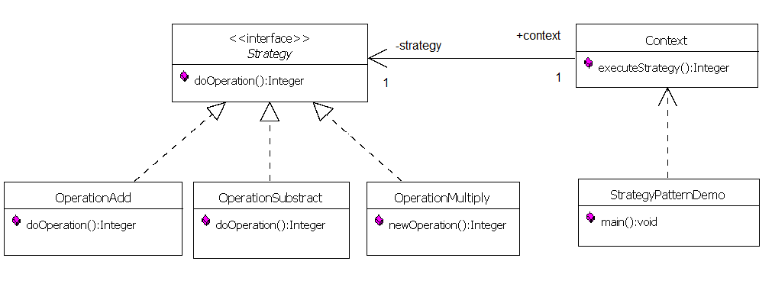
The Strategy Pattern
In Strategy pattern, a class behavior or its algorithm can be changed at run time. This type of design pattern comes under behavior pattern.
In Strategy pattern, we create objects which represent various strategies and a context object whose behavior varies as per its strategy object. The strategy object changes the executing algorithm of the context object.

Slide 50
The Strategy Pattern_2
public static void main(String[] args) {
Context context = new Context(new OperationAdd());
System.out.println("10 + 5 = " + context.executeStrategy(10, 5));
context = new Context(new OperationSubstract());
System.out.println("10 - 5 = " + context.executeStrategy(10, 5));
context = new Context(new OperationMultiply());
System.out.println("10 * 5 = " + context.executeStrategy(10, 5));
} .

Slide 51
The Strategy Pattern_3
public Context(Strategy strategy){
this.strategy = strategy;
}
public int executeStrategy(int num1, int num2){
return strategy.doOperation(num1, num2);
}

Slide 52
The Strategy Pattern_4
@Override
public int doOperation(int num1, int num2) {
return num1 + num2;
}
@Override
public int doOperation(int num1, int num2) {
return num1 - num2;
}
@Override
public int doOperation(int num1, int num2) {
return num1 * num2;
}

Slide 53
Object Design Activities
1. Reuse: Identification of existing solutions
Use of inheritance
Off-the-shelf components and additional solution objects
Design patterns
2. Interface specification
Describes precisely each class interface
3. Object model restructuring
Transforms the object design model to improve its understandability and extensibility
4. Object model optimization
Transforms the object design model to address performance criteria such as response time or memory utilization.
Object
Design
Mapping
Models to
Code

Slide 54
Modeling of the Real World
Modeling of the real world leads to a system that reflects today’s realities but not necessarily tomorrows.
There is a need for reusable and flexible designs
Design knowledge such as the adapter pattern complements application domain knowledge and solution domain knowledge.

Slide 55
References for Patterns examples
Design Patterns in Java Tutorial
https://www.tutorialspoint.com/design_pattern/index.htm

